Slide 1


Assignment 2 Portfolio
By Daniel Edwards & Matthew Haydon

Slide 2
Topic Info
MediSecure - recent victim of a ransomware attack.
Breach originated from 3rd party – MoveIt.
The attack is still in progress.

Slide 3
MoveIt
An SQL injection vulnerability had been found in the MOVEit Transfer web application that could allow unauthorised attackers to gain access to MOVEit Transfer's database.
Was then exploited in May and June of 2023.
Versions with vulnerability:
2021.0.6 (13.0.6)
2021.1.4 (13.1.4)
2022.0.4 (14.0.4)
2022.1.5 (14.1.5)
2023.0.1 (15.0.1)

Slide 4

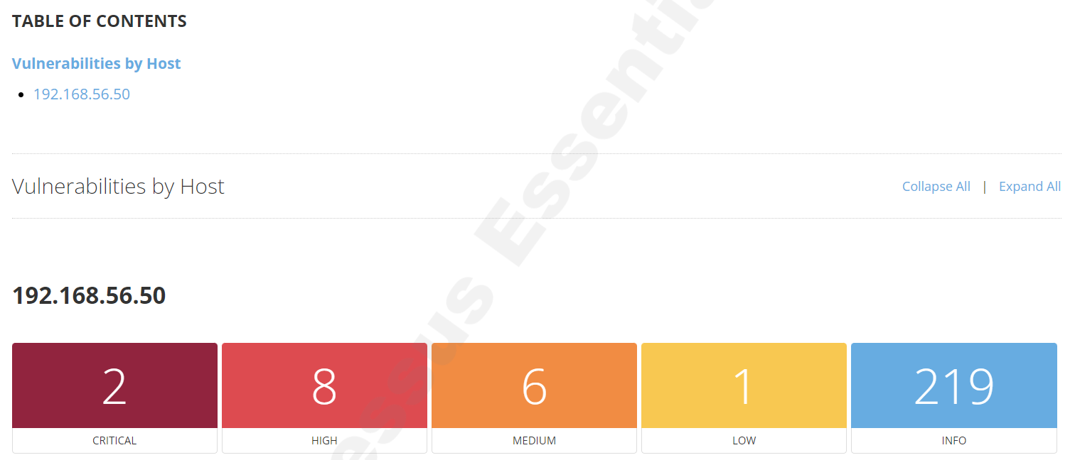

Win2022 Vulnerabilities
Search tools used - Nessus, Nikto, Legion, Nmap
Successful – Nessus

Slide 5
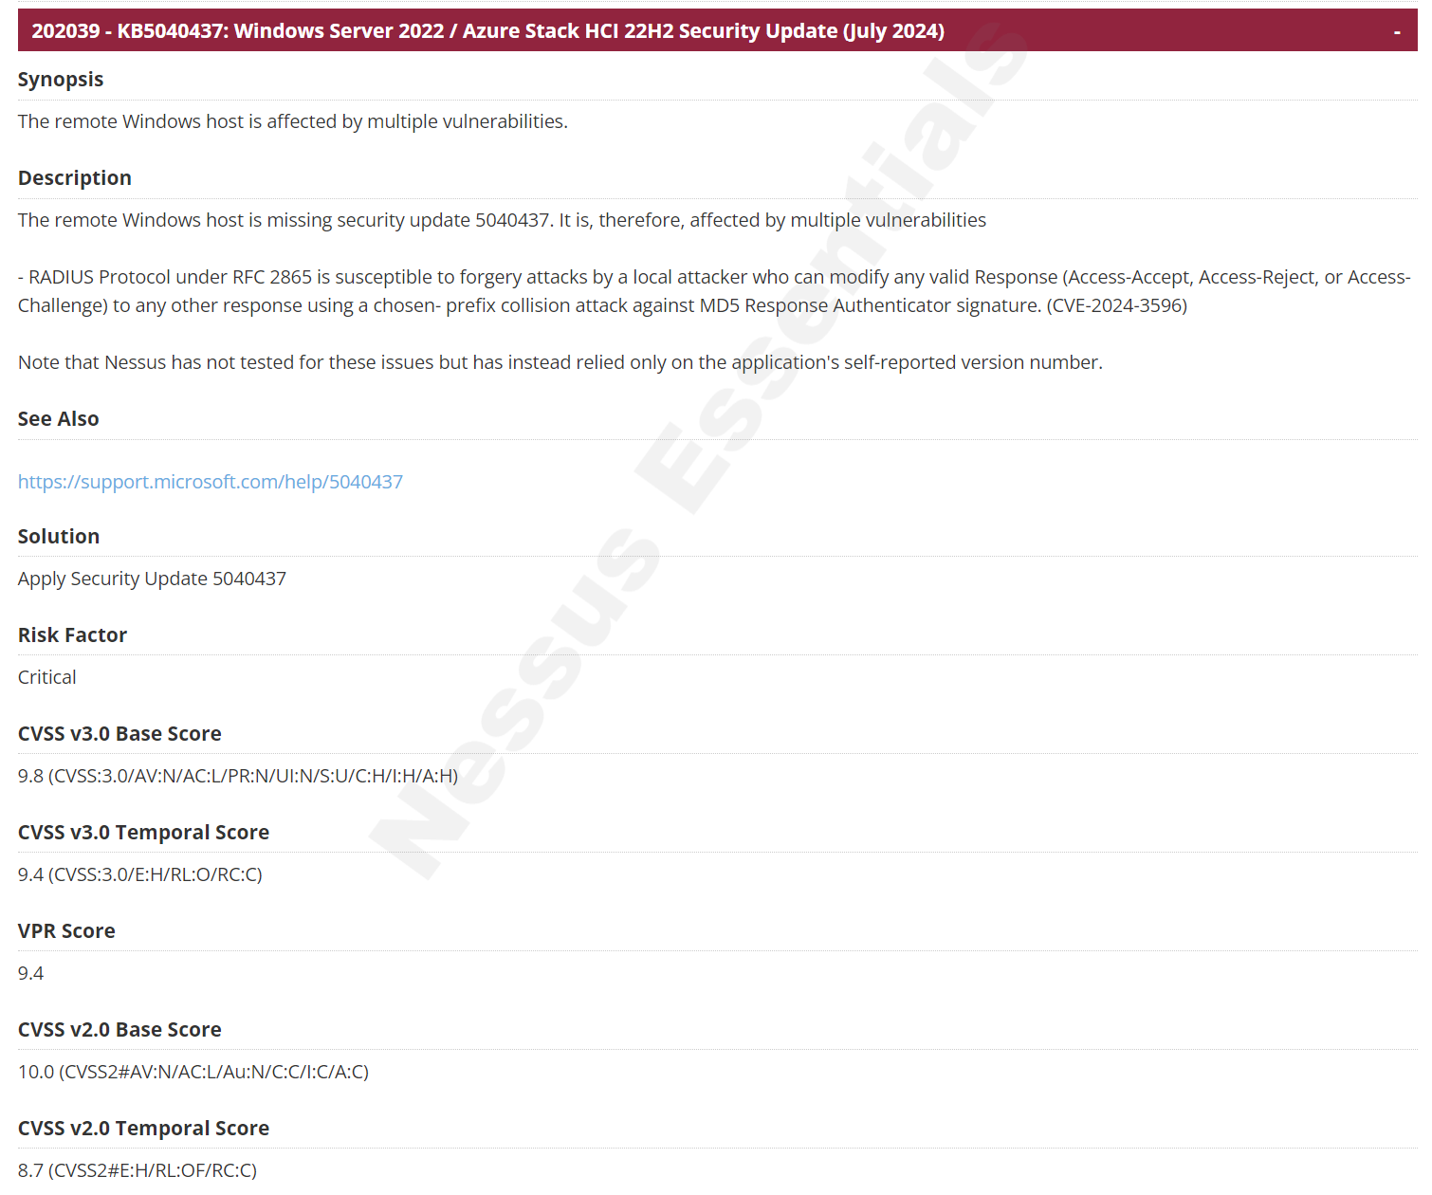

Slide 6
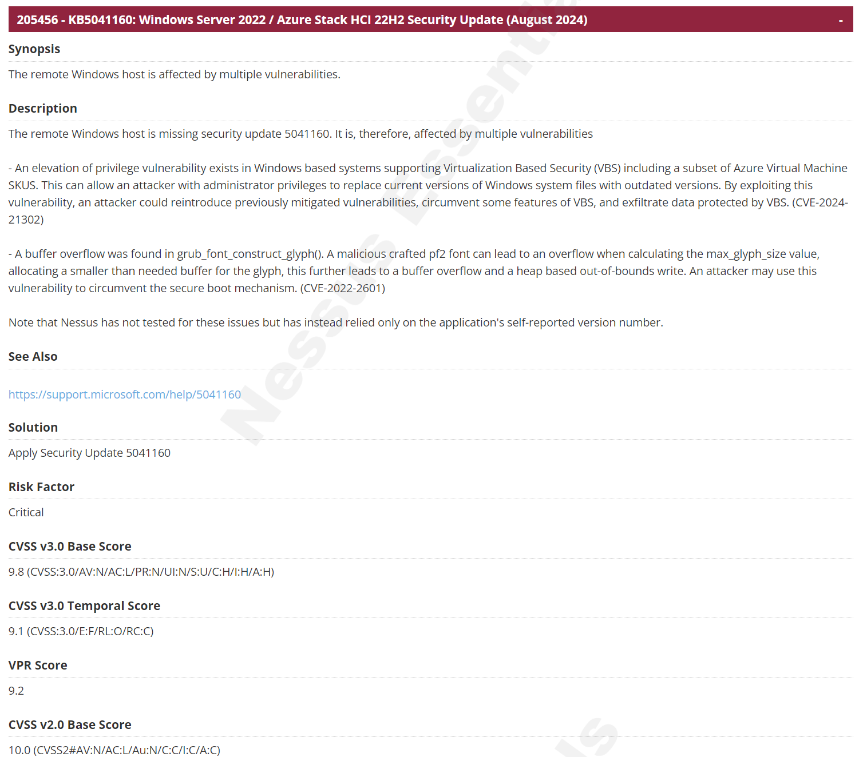

Slide 7
Who is the most likely threat actor?
How do we find this out?

Slide 8

Cyber Threat Intelligence
Motive
Patterns
Techniques

Slide 9

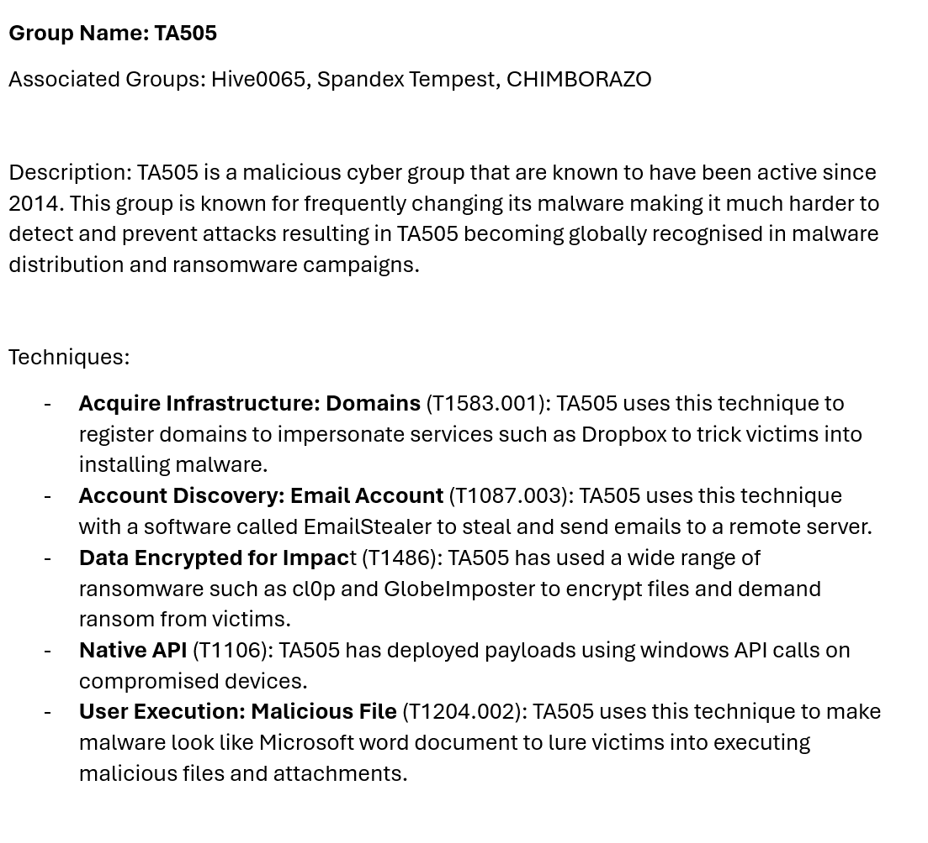
TA505

Slide 10
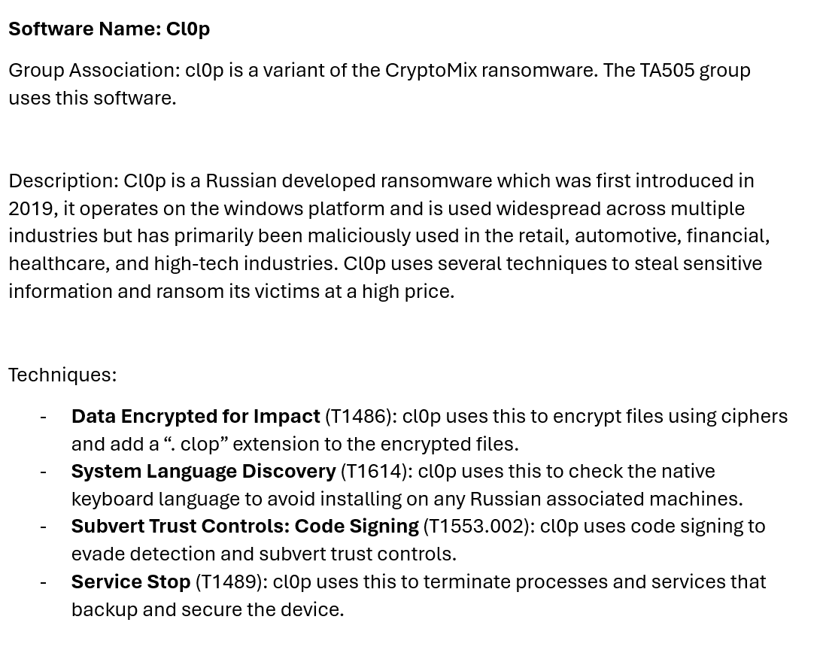
cl0p

Slide 11
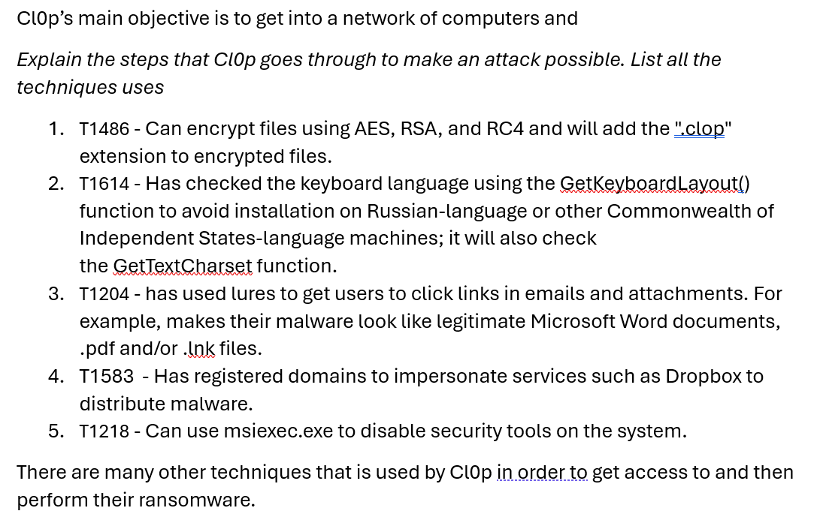
cl0p’s Lifecycle

Slide 12
Threat Actor
We believe that based on the CTI conducted, the most likely Threat Actor is Cl0p due to previously exploiting a zero-day vulrability through MoveIt. This is the CVE https://nvd.nist.gov/vuln/detail/CVE-2023-34362 That then leads to this: CWE-89 https://cwe.mitre.org/data/definitions/89.html
Several sources have been used to match the techniques we have found to several techniques cl0p have previously used.

Slide 13
Likelihood of CVE exploitation by TA505
As we work at Medisecure, we use the company MoveIt to securely transfer files and help with automation. There are a couple of zero-day vulnerabilities inside MoveIt that the attack likely has come from.
These CVE’s are:
CVE-2023-34362
CVE-2023-35708
CVE-2023-36934

Slide 14
Likelihood of CVE’s
All CVE’s have very similar in nature properties
CWE | CAPEC | ATT&CK | Used By Threat Actor
89 | 108 - Command Line Execution through SQL Injection | T1059 - Command and Scripting Interpreter | Yes, TA505 uses command line execution, but not through SQL injection
 | 470 - Expanding Control over the Operating System from the Database | T1534 - Internal Spearphishing | No, not in ATT&CK
 |  | T1659 - Content Injection | No, not in ATT&CK
 | 109 - Object Relational Mapping Injection | T1650 - Acquire Access | No, not in ATT&CK
 | 110 - SQL Injection through SOAP Parameter Tampering | T1190 - Exploit Public-Facing Application | No, not in ATT&CK

Slide 15
Prioritise Vulnerabilities
CVE-2023-34362
CVE-2023-35708
CVE-2023-36934
All of these’s CVE’s are very similar in nature
All CVE’s have SQL Injection
TA505 techniques don’t match with the techniques from the CVE’s
Unlikely that these vulnerabilities are exploited by TA505

Slide 16

Emulating an Attack

Slide 17
Technique 1: T1614
Emulating how cl0p would check if the system is Russian, based on the native installed language.
Prevents attacking “one of their own”.
Would be done using the function “GetKeyboardLayout” against the hardcoded values.

Slide 18
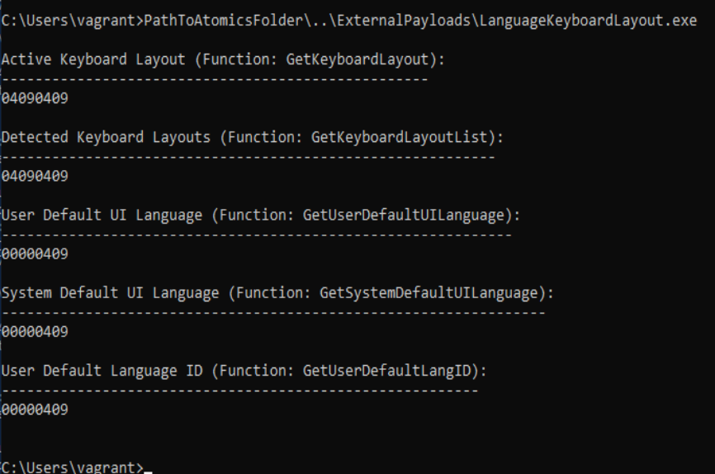
In this example, our system (win2022) shows 0409 which when checked in the OS hex meaning it comes to English - United States. Therefore, if this where to be realistic cl0p would then proceed with the malware attack.

Slide 19
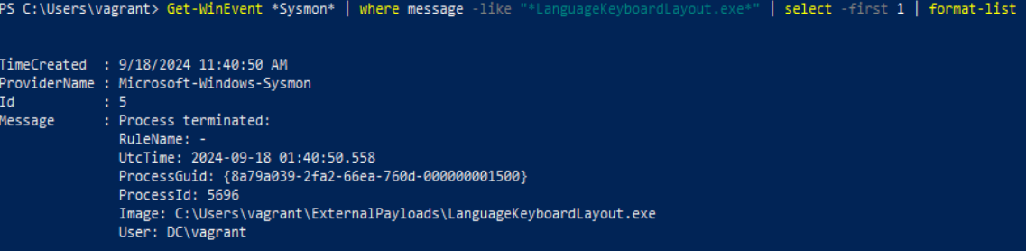
Detection
Sysmon was used in PowerShell to display a list to monitor and log system activity to the Windows event log.
Get-WinEvent *Sysmon* | where message -like "*LanguageKeyboardLayout.exe*" | format-list

Slide 20
Technique 2: T1486
Emulating how cl0p can encrypt files using AES, RSA, and RC4 and will add the ".clop" extension to encrypted files.

Slide 21
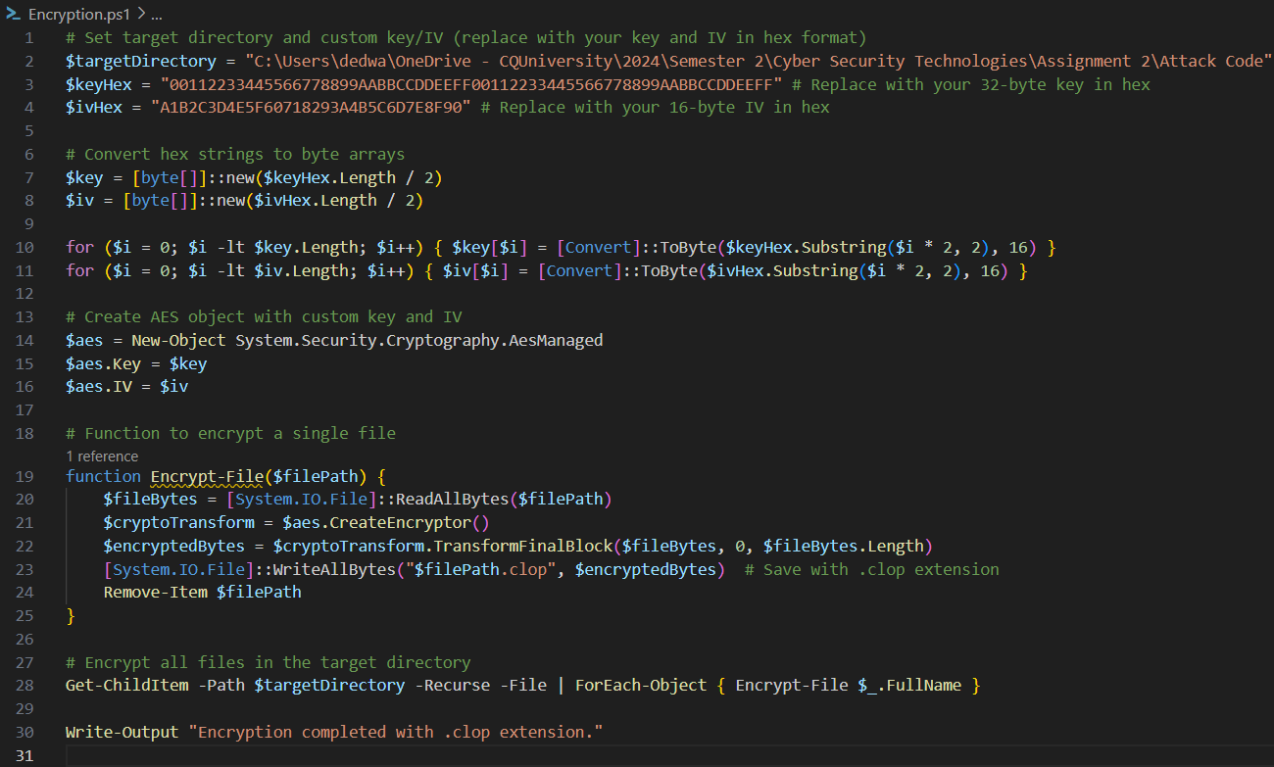
This example shows the process and code involved with encrypting files and creates a new file with .clop extension

Slide 22
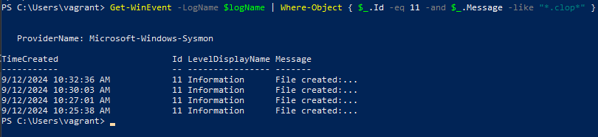
Detection
Sysmon used again to check Event ID 11: FileCreate
File create operations are logged when a file is created or overwritten.
Get-WinEvent -LogName $logName | Where-Object { $_.Id -eq 11 -and $_.Message -like "*.clop*" }

Slide 23
Github Link
https://github.com/IceFire4/Assignment_1_Daniel_Edwards_Matthew_Haydon

Slide 24
References
Cybereason 2023, Cybereason vs. clop ransomware, viewed 17 September 2024, https://www.cybereason.com/blog/research/cybereason-vs.-clop-ransomware
Dark Reading 2023, Cl0p claims moveit attack: how the gang did it, viewed 17 September 2024, https://www.darkreading.com/cyberattacks-data-breaches/cl0p-claims-moveit-attack-how-gang-did-it
MITRE 2023, APT39, viewed 17 September 2024, https://attack.mitre.org/groups/G0092/
MITRE 2023, Clop, viewed 17 September 2024, https://attack.mitre.org/software/S0611/
National Institute of Standards and Technology (NIST) 2023, Vulnerability summary for cve-2023-34362, viewed 17 September 2024, https://nvd.nist.gov/vuln/detail/CVE-2023-34362
Red Canary Co. 2024, Atomic red team t1486: data encrypted for impact, viewed 17 September 2024, https://github.com/redcanaryco/atomic-red team/blob/master/atomics/T1486/T1486.md
Red Canary Co. 2024, Atomic red team t1614.001: system location discovery, viewed 17 September 2024, https://github.com/redcanaryco/atomic-red-team/blob/master/atomics/T1614.001/T1614.001.md

